Slide 1
Reinforcement Learning Car
Presenter:
Boyang ‘David’ Dai

Slide 2
Outline
Fundamentals
Reinforcement Learning
Q-Learning
Learning Rule
Q-Learning
Table-based
Neural-net-based
Conclusion

Slide 3

Fundamentals

Slide 4
Fundamentals
Reinforcement Learning:
Basic reinforcement learning model is comprised of:
a set of environment and agent states S
a set of actions A of the agent
policies of transitioning from states to actions
rules that determine the scalar immediate reward of a transition
rules that describe what the agent observes
The goal of a reinforcement learning agent is to collect as much reward as possible, so as to maximize a numerical cumulative reward signal
Well-suited to problems which include a long-term vs. short-term reward trade-off

Slide 5
Fundamentals
Q-Learning (Visual):
Q (states, actions) or ( Q(s, a) )
Reinforcement
Evaluation Function
Update Function
Action
States
Reinforcement Function
Training Field
Notes:
Learning Rate: (0, 1]; The higher the value, the more the most recent information is considered.
Discount Factor: [0, 1]; The higher the value, the more importance of future rewards would be.
S: set of states
A: set of actions
P(s, s`, a): probability to get from state s to state s` with action a.
R(s, s`, a): immediate reward after going from state s to state s` with action a.
γin [0, 1]: discount factor, demines if one focus on immediate rewards, the total reward or some trade-off

Slide 6
Fundamentals
Q-Learning:
A model-free RL technique, consists of an agent, states S and a set of actions per state A. Executing an action in a specific state provides the agent with a reward.
The problem model works by learning an action-value function that ultimately gives the expected utility of taking a given action in a given state and following the optimal policy thereafter.
Formula:
Q(s, a) ⬅ Q_{t}(s, a) + α * [r + γ * max_{α’}Q(s’, a’) – Q(s, a)]
or: Q(s, a) ⬅ (1 – α) * Q_{t}(s, a) + α * [r + γ * max_{α’}Q(s’, a’)]
where:
s’ is the next state
a’ is the optimal action in s’
α is the learning rate. Higher value indicates more recent information is considered.
γ is the discount factor. Higher value indicates future rewards would have more importance.
Notes:
Learning Rate: (0, 1]; The higher the value, the more the most recent information is considered.
Discount Factor: [0, 1]; The higher the value, the more importance of future rewards would be.

Slide 7
Fundamentals
Learning Rules:
The car moves around the background frame by frame
Whenever the car hits the periphery or the obstacles, it will ‘crash’ and go back to the original point.
The car has three actions: Turn Left, Turn Right, and Go Straight.
10 sensors stretch out to sense the distance between the car and obstacles, making up the state space.
Notes:
State:

Slide 8
Fundamentals
Learning Rules (cont.):
Add randomness in action selection
Set small number ɛ (ɛ will decay).
Every time it makes a decision, it generates a number z, ranging from 0 to 1.
Compare z and ɛ:
If z < ɛ, we randomly make a decision (exploration)
If z > ɛ, we find the action with maxQ (exploitation)
Reward Function:
R = -500 if car hit anything
R = -20 if sensors sense anything
R = 100 if sensors sense nothing
Notes:
State:

Slide 9
Q-Learning

Slide 10
Q-Learning
Table-Based:
Q(S’, a), where a is an action and s is a state, is the expected value (cumulative discounted reward) of doing a in state s and then following the optimal policy
Table-Based Q-Learning uses temporal differences to estimate the value of Q(S’, a). The agent maintains a table of Q[S, A], where S is the set of states and A is the set of actions. Q[s, a] represents its current estimate of Q(S’, a).
The agent can use the temporal difference equation to update its estimate for Q(S, A):
Q(S, A) ⬅ (1 – α) * Q(S, A) + α * [R + γ * max_{α’}Q(S’, a’)]

Slide 11
Q-Learning
Table-Based (diagram):
Agent
1. Initialize Q-learning Func.
2. Place the car at its init. loc.
3. Get current state
4. Determine an action
5. Perform the action and determine the new state
6. Get associated reinforcement values and update the table
7. Repeat 3-5 above until the car get crashed
8. Repeat 2-6 above for the total number of runs during the experiment
Action Selector
Action
Q-Factor Table
Reinforcement
Input
Training Field

Slide 12
Q-Learning
Neural-net-based:
The Table-Based Q-Learning is favorable for its simplicity of implementation. However, as the state-action space becomes more complex, it becomes increasingly difficult to train and update the table as the environment is explored. Thus, q-learning can be implemented using a neural network as a function approximator for q-values.
Structure of the neural network:
7 input nodes (4 for the state representation and 3 for the car actions)
1 hidden layer
3 output node
50 x 25 x 3

Slide 13
Q-Learning
Neural-net-based (diagram):
1. Initialize Q-learning Func.
2. Place the car at its init. loc.
3. Get current state
4. Obtain Q(s, a) for each action
5. Determine an action so as to be able to balance between exploration and exploitation
6. Robot moves and gets new state
7. Get the associated reinforcement values for taking the particular action in the previous state
8. Generate Q^{target} according to primary equation and use it to train the net
9. Repeat 3-8 until the car get crashed
10. Repeat 2-9 for the number of runs of the experiment
Agent
Action Selector
Action
Q-Factor Table
Reinforcement
Input
Delay
Training Field

Slide 14
Conclusion

Slide 15
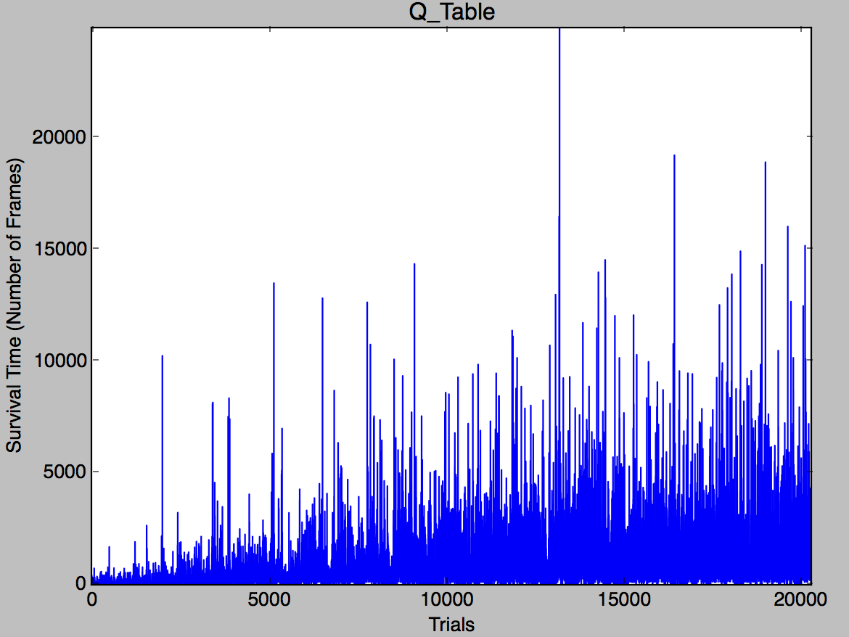
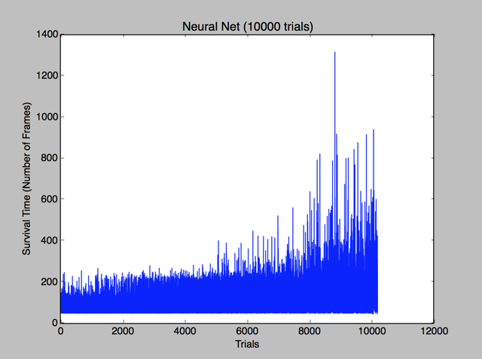
Conclusion
Results:
mean: 2558.16
std: 773.12
mean: 139.32
std: 87.12
Conclusion:
Q-Learning provides an effective unsupervised learning technique for training our robocar
Neural-net-based Q-learning improves over time, nut not as same rate as Table-based Q-learning.

Slide 16
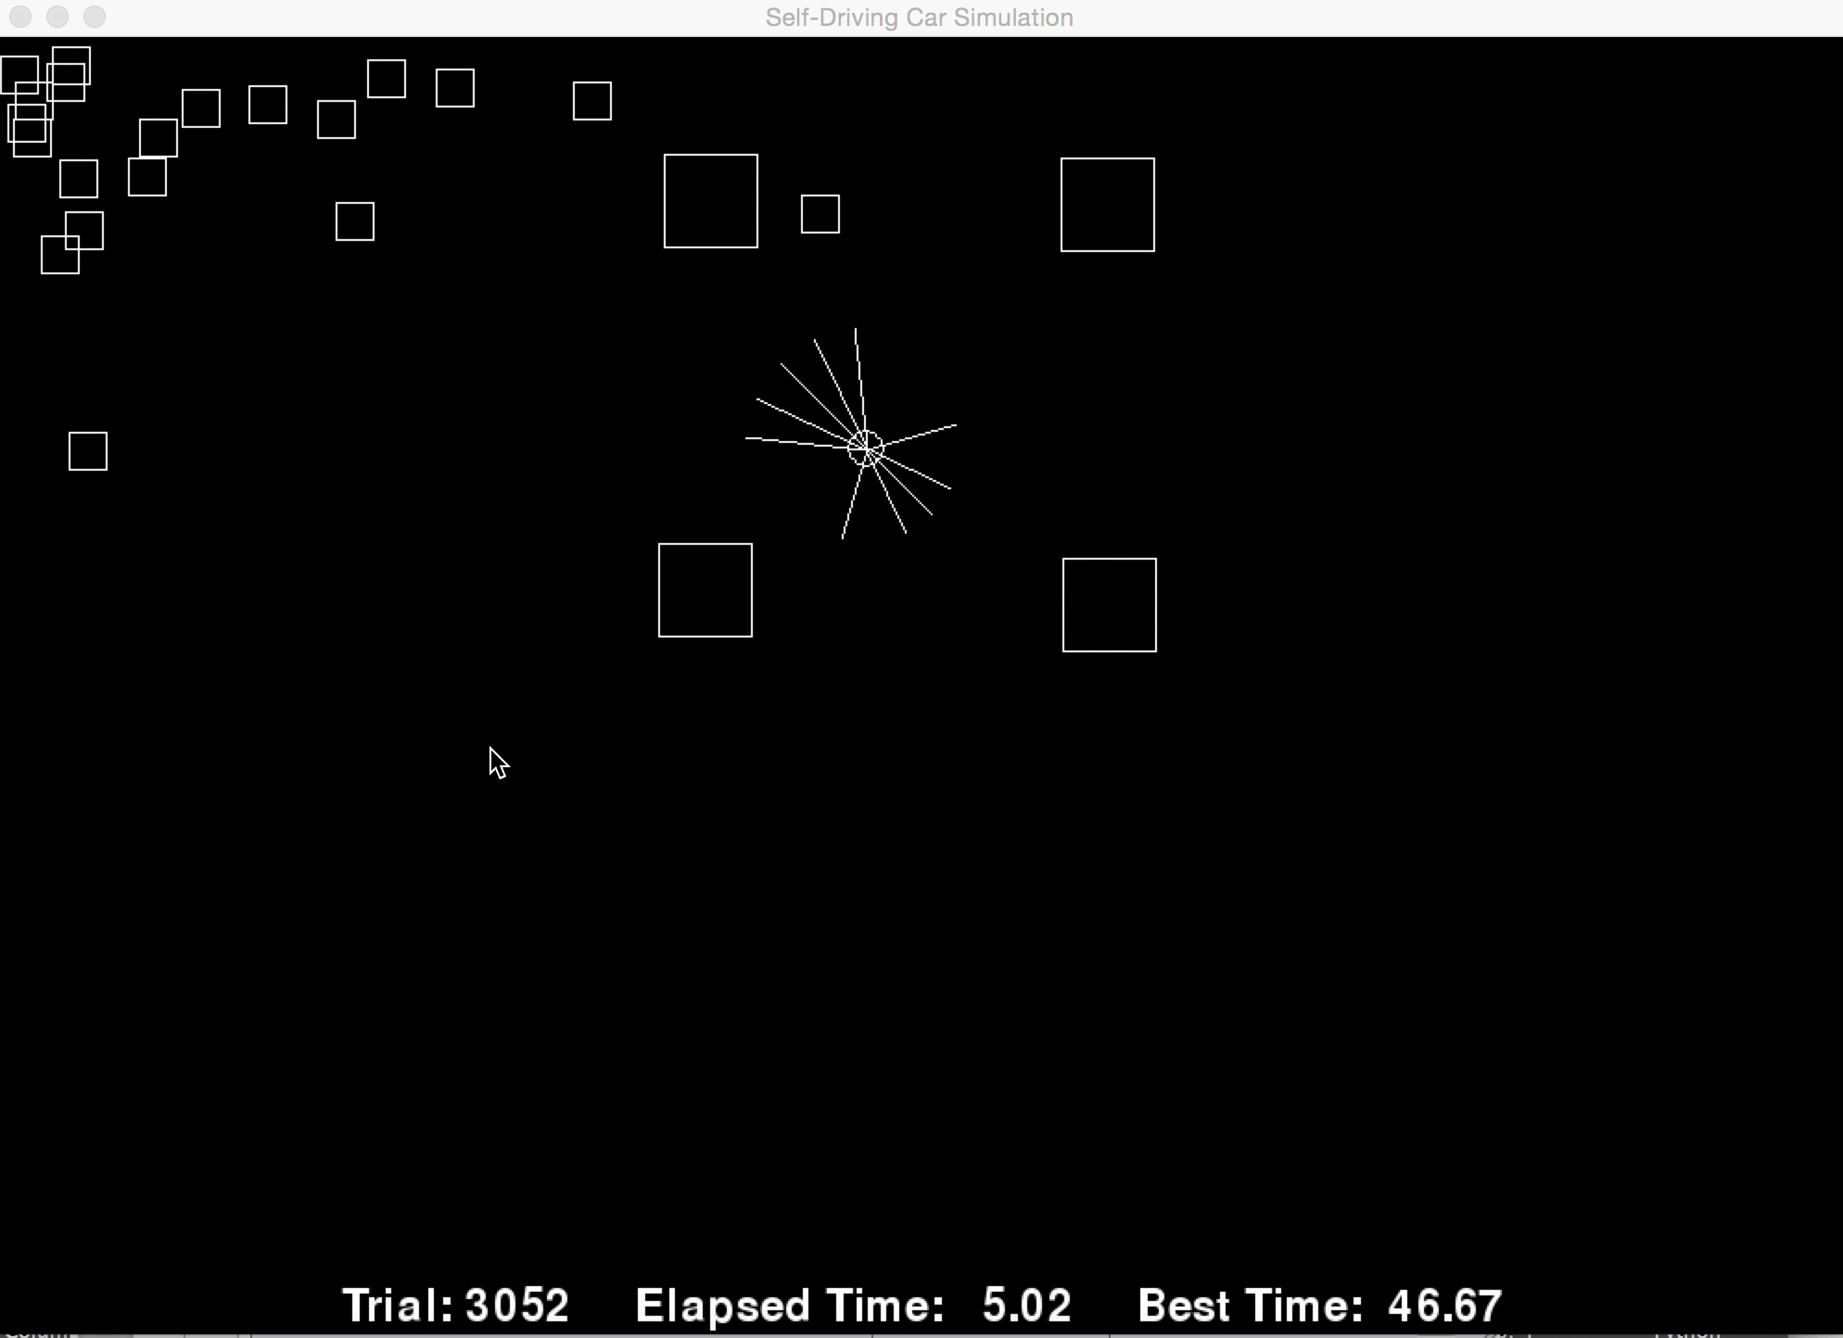
Conclusion
Visual Display:

Slide 17
Thank you.

Slide 18
Fundamentals
Q-Learning (Visual):
Take action and store previous state:
(S, A, P, R,γ)
Calculate the reward of previous action at previous state
Initial Q-Learning Function
Policy (π)
Update state and reward
Update Q-Learning Function
Core of reinforcement learning:
Find the optimal policy that maximize reward.
Value iteration update
Notes:
Learning Rate: (0, 1]; The higher the value, the more the most recent information is considered.
Discount Factor: [0, 1]; The higher the value, the more importance of future rewards would be.
S: set of states
A: set of actions
P(s, s`, a): probability to get from state s to state s` with action a.
R(s, s`, a): immediate reward after going from state s to state s` with action a.
γin [0, 1]: discount factor, demines if one focus on immediate rewards, the total reward or some trade-off

